Slide 1


Loan Approval Prediction Website Using ML
Under Guidance Of :
Mr D. Krishna Prasad
BY :
L. Vishesh Reddy - 21891A05A4
A. Sneha - 21891A0572
K. Anuhas - 21891A05A1
N. Yashwanth - 21891A05B3
⮚M. Muzammil - 22895A0508

Slide 2

Contents :
Abstract
Introduction
Overview
System design
Block Diagram
Result
Conclusion

Slide 3

Abstract
This project aims to develop a web-based loan approval prediction system using ML algorithms. The system will collect applicant information, perform data preprocessing and utilize trained ML models to predict loan approval status. The system will provide a user-friendly interface for applicants to submit their information and receive instant loan approval predictions.

Slide 4

Introduction
This project endeavors to establish a sophisticated web-based loan approval prediction system, incorporating cutting-edge Machine Learning (ML) algorithms. Through the integration of meticulously trained ML models, the system is poised to furnish prompt loan approval predictions via an intuitive and user-friendly interface, streamlining the information submission process for applicants.

Slide 5
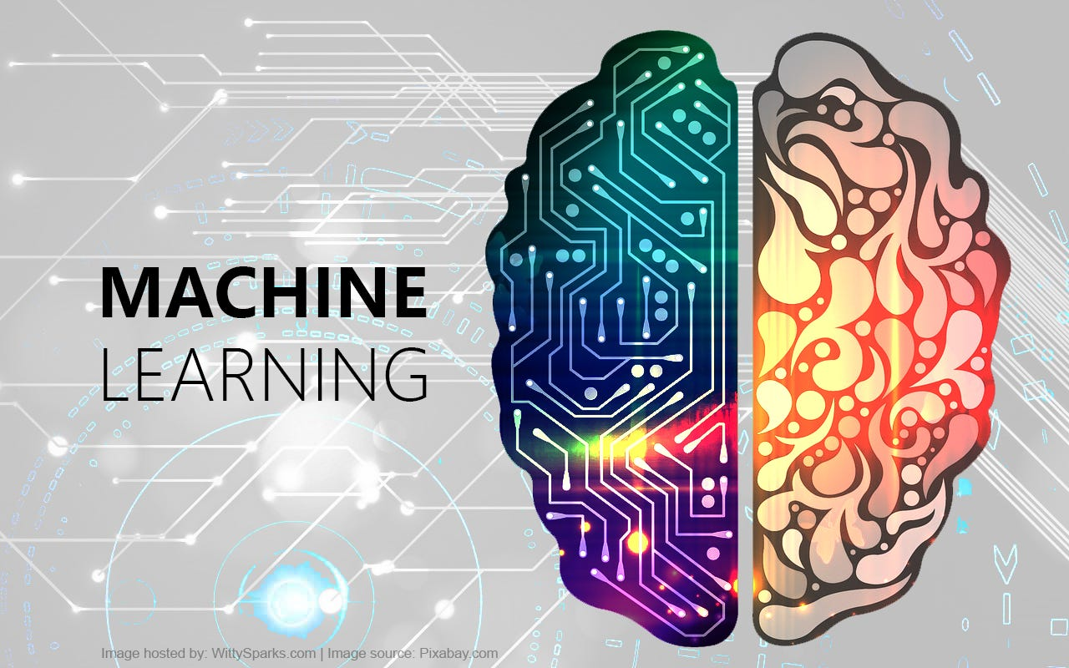
Overview Of Machine Learning
Machine learning in website development involves the use of algorithms to analyze user data, predict loan approval outcomes
and application process. By utilizing ML models, websites can offer personalized recommendations, detect potential fraud, and automate decision-making, resulting in a more efficient and accurate loan approval system.

Slide 6
System Design
The following languages are used to develop the app:
Visual Studio IDE
HTML
JavaScript
CSS
Python

Slide 7
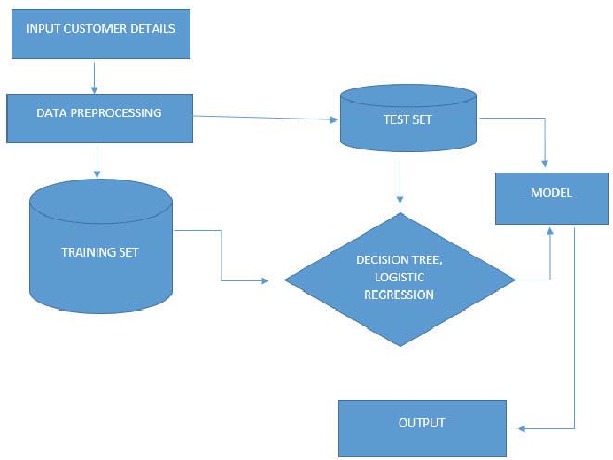
Block Diagram :
Trained a machine learning model using [data type] to predict loan approval

Slide 8
Result
A Website which takes user data and predict Loan Approval Status
Trained a machine learning model to predict loan approval
Features include Like Do’s And Don’ts

Slide 9
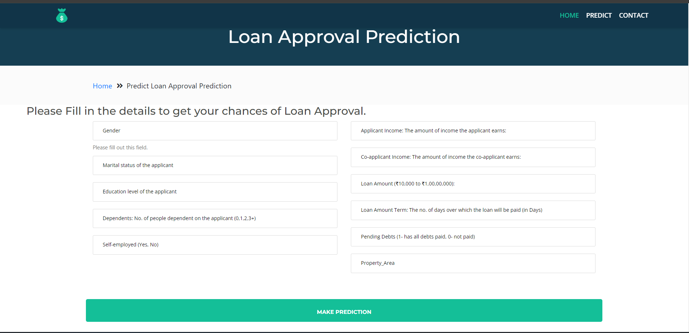
Result
q

Slide 10
Conclusion
In conclusion, this project pioneers a web-based loan approval prediction system using state-of-the-art ML algorithms. By seamlessly integrating data processing and user-friendly interfaces, it enhances the loan application process. Its streamlined approach improves decision-making for financial institutions. of the loan approval landscape

Slide 11


